Slide 1
ANESTHESIA FOR MULTIPLE TRAUMA & SHOCK PATIENTS
By:-Wubayehu Amare (MSC, lecturer)

Slide 2
Objectives
At the end of this course students are expected to:
Identify mechanisms of trauma
Discuss assessment of trauma patient
Describe concepts of trauma care
Elaborate anesthesia management of trauma patient

Slide 3
Brainstorming questions
What is the definition of trauma?
Why is trauma considered a leading cause of death in certain age groups worldwide?
How do we classify trauma based on the mechanism of injury

Slide 4
Introduction to trauma
Impact of Trauma on Global Health
Leading Cause of Morbidity and Mortality:
Responsible for 9% of total annual mortality worldwide (over 5 million deaths)
Vulnerable Age Groups: Major cause of death in the young (under 20 years) and the elderly (over 70 years).
WHO Findings:(2020) ; Injury is the leading cause of death globally for both men and women aged 15 to 44 years.

Slide 5
Cont….
Trauma Statistics in the USA(CDC, 2020).
Third leading cause of death across all age groups
Consequences of Injury: Millions suffer physical and psychological effects, impacting patients, families, and society as a whole.
Key Role of Anaesthetists
Anaesthetists are crucial members of the trauma care team, ensuring safe and effective management of anaesthesia during trauma interventions.

Slide 6
Cont..
Ethiopia has one of the highest rates of road traffic fatalities
18 deaths per 100,000 people annually.
Trauma accounts for about 25% of all emergency department visits in urban hospitals in Ethiopia.( 2020)
Besides road traffic accidents and conflict-related injuries, other causes include domestic violence, workplace injuries, and agricultural accidents.

Slide 7
Cont…
Anesthetists/anesthesiologists are involved from the emergency department through to the critical care unit.
Key Responsibilities:
Emergency Airway Management: Initial assessment and intervention.
Resuscitation Treatment: Support during critical care phases.
Operating Room Care: Anaesthesia management during surgical procedures.
Impact on Critical Care:
Trauma patients represent a significant portion of the workload for critical care and pain management specialists.

Slide 8
Cont…
Anesthesia for trauma patients is different from routine OR practice. WHY?
Urgent Situations: usually off hours
Limited Patient Information
Patient Condition: intoxicated, full stomach and c-spine fracture
Multiple injuries and occult injures

Slide 9
Cont…
Unique Challenges:
Requires rapid assessment and adaptation to evolving situations, differing from routine anaesthesia protocols.
Prioritization in management is essential to address the most critical injuries first.

Slide 10
The Golden Hour and Golden Period in Trauma Care
Golden Hour:(strictly)
Definition: The first 60 minutes after a traumatic injury.
This period is considered critical for ensuring the survival of severely injured patients.
Focus: Immediate care, especially to prevent shock, hemorrhage, and airway compromise..
Notes:
Introduced by Dr. R Adams Cowley at the Shock-Trauma Center, Baltimore.

Slide 11
Cont…
Key Concept: The sooner treatment is given within this hour, the better the survival chances.
Focuses on prehospital care and early emergency interventions.
Introduced by Dr. R Adams Cowley at the Shock-Trauma Center, Baltimore

Slide 12
Cont
Golden Period( flexible )
Definition: A broader window of time following trauma where timely intervention is still crucial.
Importance: Critical care may extend beyond 60 minutes depending on the injury type.
Involves ongoing care that may include emergency, surgical, and intensive care beyond the first hour.

Slide 13
Definition to Trauma
From the Greek word “trauma,” meaning "a wound.
Definition:
A serious injury resulting from mechanical, chemical, thermal, electrical, or other forms of energy.
Includes both physical injury and psychological distress.
It activates the HPA axis and triggers immunologic and metabolic responses essential for restoring homeostasis.

Slide 14
Physiological Response to Trauma
HPA Axis Activation:
Initiation of the stress response cascade.
Release of cortisol and catecholamines (epinephrine and norepinephrine).
Immunological Response:
Activation of innate and adaptive immune systems.
Inflammation as a protective response to injury.
Metabolic Changes:
Increased metabolic rate to support healing.
Release of glucose and fatty acids for energy.

Slide 15
Mechanism of trauma
Transfer of energy occurs due to blunt, decceration and penetrating trauma.
Factors Affecting Injury Severity
1.Kinetic Energy Absorption:
(KE = 1/2 mass × velocity²)
Higher mass and velocity result in greater kinetic energy and potentially more severe injuries.
Notes:
according to Sir Isaac
Newton’s first law of motion, which states that “a body in motion will stay in motion unless
acted upon by an outside force.”

Slide 16
Cont..
2. Direction of Energy Transmission:
The path that the energy takes through the body can influence the type and extent of injuries.
3. Body Structure Density:
Solid Organs:
These organs (like the liver or spleen) are denser and more likely to rupture under high-energy impacts.
The density makes them less flexible, leading to potential tearing or breaking.

Slide 17
Cont…
Hollow Organs:
These organs (like the stomach or intestines) can sustain damage but are less likely to rupture under blunt force.
Bone and Cartilage:
These structures are rigid and have a greater density, providing support but also making them susceptible to fractures when subjected to high-energy impacts

Slide 18
Cont….
Categories of Trauma
1. Penetrating Trauma
2. Blunt Trauma
3. Deceleration Trauma
individual Responses
Responses to trauma can vary significantly between individuals.
Underlying chronic medical conditions may alter normal physiological responses.

Slide 19
Penetrating trauma
Definition:
Injury caused by a foreign object piercing the skin, damaging underlying tissues and resulting in an open wound.
Common Causes:
Gunshots
Explosive devices
Stab wounds

Slide 20
Cont…
Types of Penetrating Wounds:
Puncture Wound:
Sharp object creates a small hole without entering a body cavity (e.g., bites).
Penetrating Wound:
Sharp object creates a single open wound and enters tissue or a body cavity (e.g., knife stab).
Perforating Wound:
Object passes completely through the body, creating both entry and exit wounds (e.g., gunshot wound).

Slide 21
Cont…
Most Frequently Affected Organ:
Small Intestine
often sustains the highest incidence of injury due to its length and location in the abdomen.
Other Commonly Injured Organs:
Liver : the second mostly affected organ
Spleen
Large Intestine

Slide 22
Cont…
Complications
Hemorrhagic Shock:
A critical consequence of penetrating trauma that can lead to death if untreated.
Presentation of Hypovolemic Shock:
Hypotension
Tachycardia
Tachypnea
Cold skin

Slide 23
Cont…
Major Consequences of Hypovolemic Shock
Decreased Organ Perfusion (vulnerable organs: kidneys, brain, heart, liver, colon)
Acute Blood Loss → Reduced Circulating Volume
Decreased Organ Perfusion → Risk of Organ Failure

Slide 24
Cont
Compensatory Mechanisms
Sympathetic Nervous System (SNS) Activation
Release of Catecholamines (e.g., norepinephrine, vasopressin)
Increased Heart Rate → Increased Cardiac Output (CO)
Renin-Angiotensin-Aldosterone System (RAAS)
Renin Release from juxtaglomerular cells (in response to low BP & NaCl)
Conversion: Angiotensin I → Angiotensin II → Aldosterone

Slide 25
Cont..
Angiotensin II:
Vasoconstriction (↑ SVR)
Stimulation of ADH release (↑ Water Reabsorption)
Goal of Compensation
Maintain Cardiac Output (CO) and Systemic Vascular Resistance (SVR)
Prevent progression to severe shock and death

Slide 26
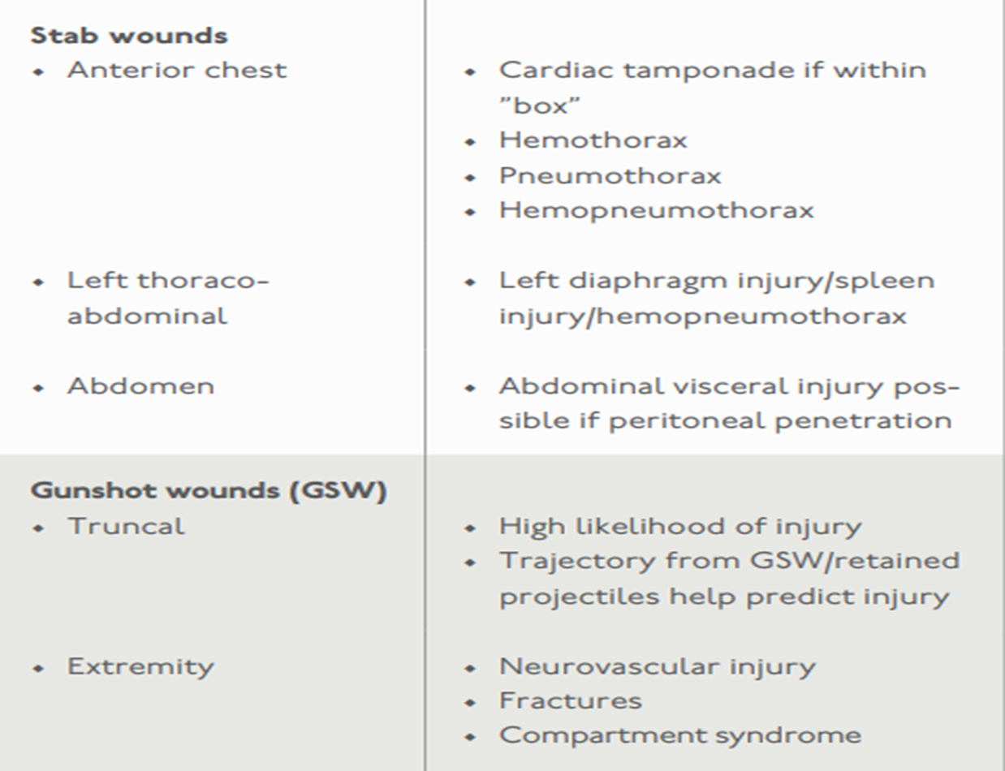

Slide 27
Blunt Trauma
Definition:
Non-penetrating injuries caused by forceful impacts to the body, often resulting from falls, physical assaults, or collisions with dull objects.
Adults: The abdomen is the most commonly injured area, particularly in motor vehicle accidents.
Solid Organ Injuries:
Liver ,Spleen, Kidneys

Slide 28
Cont…
Liver Injury:
Typically results in venous hemorrhage rather than arterial.
Management is usually conservative, focusing on monitoring and supportive care
Complications of Blunt Trauma:
Internal hemorrhage is a significant concern.
Inflammation and edema are common underlying effects following injury.

Slide 29
Cont…
Four Cardinal Signs of Inflammation:
Redness
Swelling
Pain
Loss of Function
Mediators of Inflammation:
Mast Cells Release:
Histamine: Causes vasodilation and increased blood flow.
Bradykinin: Causes vasodilation and Sensitizes nerve endings, leading to pain.

Slide 30
Cont..
Edema in Acute Inflammation:
Mechanism:
Endothelial contraction and damage lead to “leaky” vessels.
Fluid shifts from post-capillary venules to interstitial space.
Neurologic Injuries from Blunt Trauma:
Epidural Hematomas:
Caused by arterial rupture (commonly from the middle meningeal artery) secondary to skull fractures.

Slide 31
Cont…
Causes of Death in Blunt Traumatic Injury
Head Trauma
Severe Loss of Blood.
Common Causes of Blunt Trauma:
Motor Vehicle Crashes (MVC)
Pedestrian vs. Vehicle Accidents
Falls

Slide 32
Cont…
1. Falls
Most common cause of non-fatal injuries
Falls from height, such as a ladder or a scaffold are more common in the working age group
In elderly population, falls are much more common and much more likely to be lethal

Slide 33
Cont…
Characteristics of the contact surface, position of the person upon landing, and change in velocity determine injury severity.
Landing on feet: full force is transmitted up the axial skeleton with injuries to the calcaneus, tibia, femoral neck, and spine. Intra-abdominal organs may be avulsed off their mesenteries or peritoneal attachments.
Landing on back: energy is transferred over a larger area.
Landing on head: severe head injury and cervical spine fractures

Slide 34
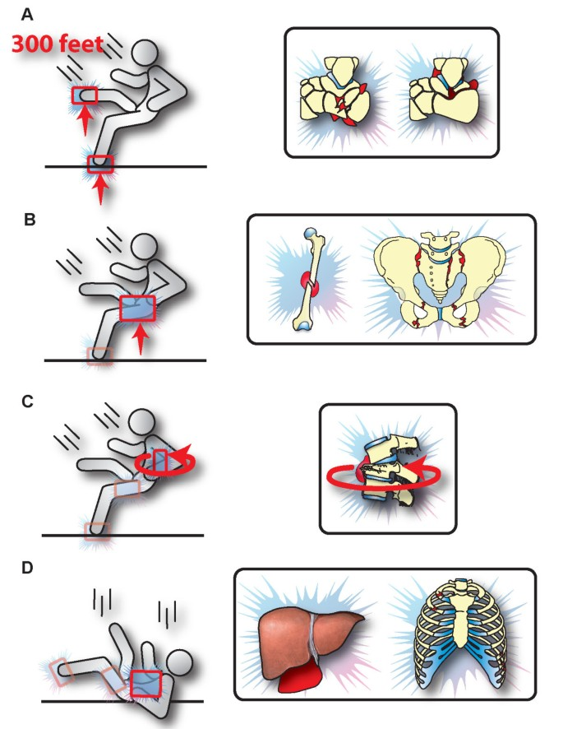

Slide 35
Cont…
2. Transportation-related Injuries
Motor vehicle collisions (MVCs) are the leading cause of death due to injury.
Injuries may occur from frontal or rear impact, from lateral and rotational impact, and due to restraint devices.
Each of these impacts is associated with characteristic patterns of injury.

Slide 36
Mechanisms of Injury:
Frontal Impact:
Common Injuries: Head, chest, and lower extremity injuries.
Typical patterns include whiplash and dashboard injuries.
Rear Impact:
Common Injuries: Neck injuries (whiplash), back injuries.
Less severe compared to frontal impacts.
Lateral (Side) Impact:
Common Injuries: Thoracic injuries, abdominal injuries.
Higher risk for occupant on the side of impact.

Slide 37
Cont…
Rotational Impact:
Common Injuries: Complex patterns affecting multiple body areas.
May result in significant torso and head trauma.
Restraint Devices:
Injuries related to seat belts and airbags.
Potential for internal injuries or fractures due to restraint forces.

Slide 38
Cont…
3. Pedestrian injuries
Injuries sustained by individuals on foot due to accidents involving:
Motor vehiclesBicyclesOther forms of transport.
Significance of Pedestrian Trauma:
High Mortality and Morbidity Rates:
Especially critical when involving high-speed vehicles.
Pedestrians are highly vulnerable due to the lack of physical protection.

Slide 39
cont
Vulnerable Populations:
Children, Elderly, and Intoxicated Persons
Injury Patterns Based on Vehicle Impact:
Bumper Impact: refers to the injuries sustained when a pedestrian is struck by the front bumper of a vehicle during a collision
Common Injuries: Tibia-fibula fractures, Knee dislocations and Pelvic injuries

Slide 40
Cont..
Hood and Windshield Impact:
Common Injuries: Truncal injuries (e.g., rib fractures), Splenic trauma
Ground Impact:
Occurs when the pedestrian slides off the vehicle.
Common Injuries: Head and face injuries, Extremity fractures

Slide 41
Deceleration Trauma
Definition:
Deceleration Trauma: Injury caused by a sudden stop in motion.
Mechanism of Injury:
Acceleration-Deceleration Injury to the Brain:
Occurs when the brain moves rapidly within the skull.
The brain strikes one area of the skull and then rebounds, impacting the opposite side.

Slide 42
Cont..
Causes of Deceleration Trauma:
Direct Forces:
Example: Head impact with the steering wheel during a motor vehicle accident.
Non-Contact Forces:
Example: Shaken baby syndrome, where rapid shaking causes the brain to move violently within the skull.
Potential Injuries:
Can lead to traumatic brain injuries, including concussions and contusions.

Slide 43
cont
Traumatic Aortic Rupture:
A potential site for deceleration injury is the aorta.
Most commonly occurs at the aortic isthmus:
This area is more mobile compared to the aortic arch.
The aortic arch is relatively stabilized by the brachiocephalic vessels at the thoracic inlet.
Implications:
Both brain and aortic injuries can lead to significant morbidity and mortality following deceleration trauma.

Slide 44
Cont..
Neurochemical Response in Deceleration Trauma
After a deceleration injury, the brain undergoes rapid movement within the skull, leading to damage to brain cells and neural pathways
Neurochemical Cascade:
In response to the injury, the body activates a series of biological processes.
Large amounts of neurochemicals (such as glutamate) and prostaglandins are released from damaged cells

Slide 45
Cont..
Effects of Neurotransmitters:
Glutamate:
An excitatory neurotransmitter that, when released in excess, can lead to excitotoxicity.
This means that neurons are overstimulated, which can cause further injury and cell death.

Slide 46
Cont..
Prostaglandins:
These are lipid compounds that have various roles in inflammation and pain.
Their release can increase inflammation in the brain, leading to swelling and further neuronal damage.
Exacerbation of Harmful Effects:
The increased inflammation and excitotoxicity contribute to a cycle of damage.

Slide 47
Cont..
This can lead to secondary injuries, such as:
Cerebral edema: Swelling of the brain, which can increase intracranial pressure.
Long-term effects: Potential development of chronic conditions such as post-concussion syndrome, cognitive deficits, or neurodegenerative diseases.

Slide 48
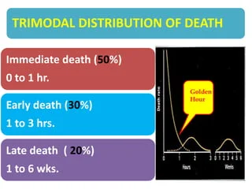
Tri-modal distribution of death

Slide 49
Tri-modal distribution of death
The trimodal distribution of trauma deaths was first articulated by baker in 1980 and later detailed by trunkey in 1983.
The trimodal distribution of death in trauma patients
refers to the observation that trauma-related fatalities tend to occur in three distinct peaks over time after the injury occurs.
It classified as : first peak, second peak and third peak of death

Slide 50
TIMING OF DEATHS
The first peak (at scene)-:50%-60% of all deaths
Immediate death occurring within minutes of the injury.
These patients are declared dead on the scene or die shortly after arrival to the hospital
These include deaths at the scene, deaths occurring within 1 hour of arrival to the hospital, and all deaths in the emergency department.
Causes: often due to catastrophic events such as severe brain injury, massive hemorrhage, or spinal cord injuries.

Slide 51
Cont…
Second peak: early death:- 25%-30% of deaths
Defined as deaths within hours of arrival to the hospital.
In most published reports, early deaths include deaths within 24 hours of arrival to a trauma center, excluding immediate deaths.
Causes: deaths in this phase are typically due to complications such as hypovolemic shock, respiratory failure, or traumatic brain injury.

Slide 52
Cont…
Third Peak: Late Death: 9-20% of deaths
“Late deaths,” defined as those occurring days to weeks after the injury among patients who survived the initial insult
This category includes deaths occurring after the first 24 hours and all other in-hospital deaths.
Causes: Usually associated with complications from the initial injuries, such as infections, multiple organ failure, or thromboembolic events.

Slide 53
Cause of death
Several studies have investigated the causes of death in trauma patients.
Baker et al found that brain injury accounted for a majority of deaths, at 50%
Heart or aortic injury (17%), hemorrhage (12%), sepsis (10%), lung injury (6%), burn (3%), and liver injury (2%) accounted for the remainder.
The majority of patients with major cardiac, vascular, or liver injury died of hemorrhage.

Slide 54
Cont….
Shackford and colleagues also found that head injury was the most common cause of death, and when combined with spinal cord injury, neurologic injuries were responsible for 49% of deaths
On autopsy, secondary brain injury, defined as diffuse cerebral edema; herniation; or cerebral necrosis due to hypoxia, hypotension, or cerebral edema that followed the primary injury was present in just over half of neurotrauma cases.
.

Slide 55
Cont…
Almost a third (31%) of victims died of hemorrhage in the chest, the abdomen, or both cavities.
Other causes of death included asphyxia in 6%, cardiac arrest in 4%, sepsis in 3%, and pneumonia in 2%

Slide 56
Causes of death by timing category
Immediate and early deaths | Late deaths | Post discharge
Brain injury | Infection | Cardiovascular disease
Hemorrhage | Multiple-organ failure | Second major trauma
 | Brain injury | Neurologic disease
 | Hemorrhage | Malignancy

Slide 57
Implications for Trauma Care
Preventive Strategies:
Understanding this distribution helps prioritize trauma care resources. Immediate resuscitation and stabilization are crucial to reduce deaths in the first two peaks.
Education and Training:
Trauma teams are trained to identify and address life-threatening conditions rapidly, particularly within the first hour after injury.
Quality Improvement:
Tracking outcomes in these time frames can help hospitals improve trauma protocols and response times.

Slide 58
References
Harold Ellis: Anatomy for Anaesthetists (8th edition). Blackwell Science Ltd, 2004.
Paul G Barash: Handbook of Clinical Anesthesia (8th edition). Lippincott Williams & Wilkins publications, Inc., 2016.
Ronald D. Miller: Millers Anesthesia (9th edition). Churchill Livingstone publication, An 157 Imprint of Elsevier, 2009.158

Slide 59
Any question?????
The end for today!!!!!!

